Slide 1
What is AVID?
Background
Purpose and Goals

Slide 2
What is AVID?
  A college and career readiness program
  A direct support system for students who have a desire to be academically successful.
  Provides tools that will help students OWN their learning.

Slide 3
The AVID mission
Advancement
Via
Individual
Determination
AVID's mission is to close the achievement gap by preparing all students for college readiness and success in a global society.

Slide 4
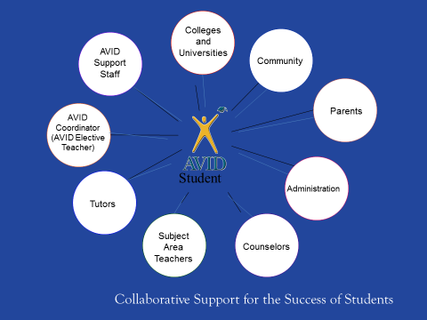

Slide 5
The AVID elective student profile
Has academic potential
  Average to high test scores
  2.0 – 3.5 GPA
    C-/B average students
  Middle of the road
  College potential with support
  Desire and determination
  Highly Motivated, just needs tools to support them academically

Slide 6
Pre-AP Classes
AVID students are enrolled in at least ONE Pre-AP class, of THEIR choice.
  Math, Science, History, ELA
  Consider strengths when deciding
To push the student
To show them that they are capable

Slide 7
What do we learn in the AVID elective?
Curriculum
Structure of the class

Slide 8
The AVID Curriculum
Strategies for Success that Support Student Determination:
Focused Note-Taking strategies
Collaboration and Communication skills
Problem Solving skills
Maximize critical thinking abilities/opportunities
Attain/improve organizational skills
Inquiry
Relational Capacity
Helps students develop confidence
Ownership of learning

Slide 9
A sample week in the AVID Elective
Sample Daily Schedule
Monday | Tuesday | Wednesday | Thursday | Friday
AVID Curriculum | Tutorials | AVID Curriculum | Tutorials | Binder Evaluations Speakers Team Building Activities
Curriculum:
Writing
College and Careers
Strategies for Success
Critical Thinking and Inquiry
Tutorials:
Collaborative Study Groups
Writing Groups
Strategic process teaching kids how to problem solve and communicate

Slide 10
What AVID is not…
A quick fix and will not work without student determination, initiative, effort, and drive.
Mrs. Sanders is here to teach, model, and facilitate proven, effective strategies to help you succeed.
AVID does not guarantee you will become a straight A student, your level of effort will determine that.

Slide 11
Benefits of AVID
Taking AVID will instill the necessary skills to be successful at any type of college.
Success looks different for each student.
It takes drive and determination to achieve student success.

Slide 12

AVID at FCMS

Slide 13
Parent Testimony
How has AVID helped your student?
Avid has helped my student to be more organized.
He’s more mature and he can handle his priorities.
AVID has been a great experience for my son, teaching him better study and homework habits and holding him accountable for writing assignments down in his agenda.
AVID is helping him develop the skills and habits he needs to be a successful student.
His grades are up, his confidence is boosted…
My Student has enjoyed the class.

Slide 14
Student Testimony
How has AVID helped you?
It has helped keep me organized. My binder doesn’t look like it exploded.
I actually use my planner.
I like tutorial days! Getting help from peers is the best!
It helped teach me how to take good notes.
I like AVID and can’t wait to take it again next year.

Slide 15
AVID at FCMS
Problem Solving
Critical Thinking
Interpersonal Skills
Communication Skills
Please contact Dawne Sanders with any questions.
Please visit our campus website for more information and to apply.

Slide 16
Applications
To apply please visit:
FCMS AVID application link
Email:
Christopher.Pryor@fortbendisd.gov

Slide 17
AVID Site Team
Admin – Melody Lucas
Counselor – Dawne Sanders
Site Coordinator – Chris Pryor (7/8 grade elective teacher)

